Slide 1
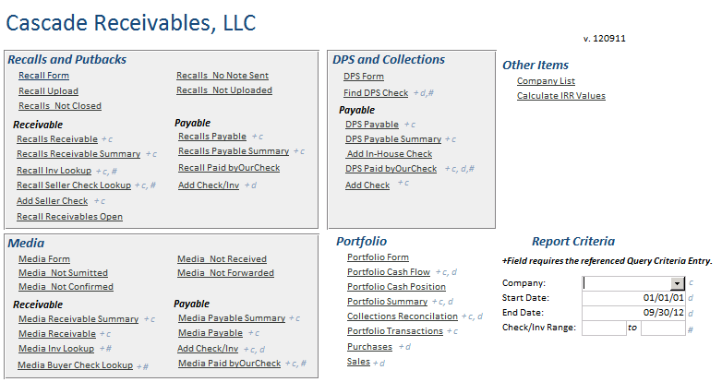
Section: Recalls and Putbacks
The following retrieve the actual data:
Recall Upload (error – does not retrieve data)
Recalls Not Closed
Recalls No Note Sent
Recalls Not Uploaded

Slide 2
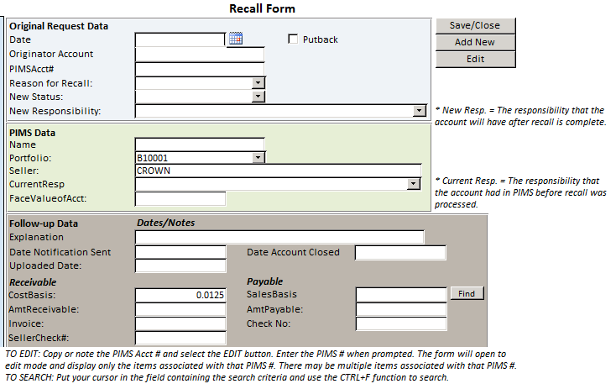
Section: Recalls and Putbacks

Slide 3
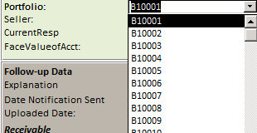
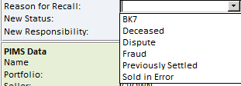
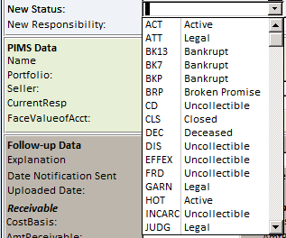
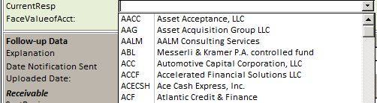
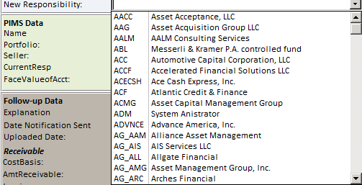
Section: Recalls and Putbacks

Slide 4
Section: Recalls and Putbacks
“Recalls Not Closed”, “Recalls No Note Sent” and “Recalls Not Uploaded” data fields include:
Date
OrigAcct#
AcctName
Portfolio#
CurrentResp
RecallReason
DateNoteSent
DataAcctClosed
PIMSAcct#
NewStatus
NewResp
Uploaded (y/n)
Check#
Inv#
Explanation
FaceValueofAcct
CostBasis
SalesBasis
RequestedBy
SellerCheck#
Putback

Slide 5
Section: Recalls and Putbacks – Receivable
The following retrieve the actual data:
Add Seller Check
Recall Receivables Open

Slide 6
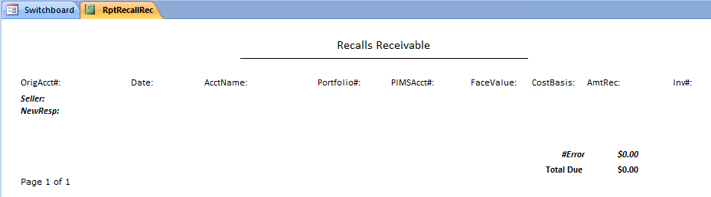
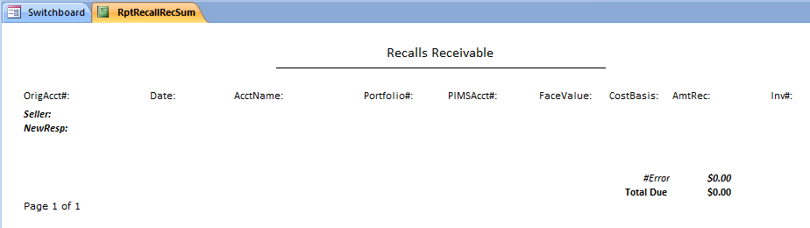
Section: Recalls and Putbacks – Receivable
Report: Recalls Receivable
Report: Recalls Receivable Summary

Slide 7
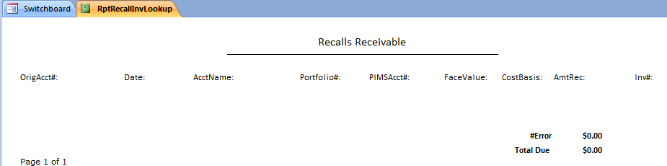
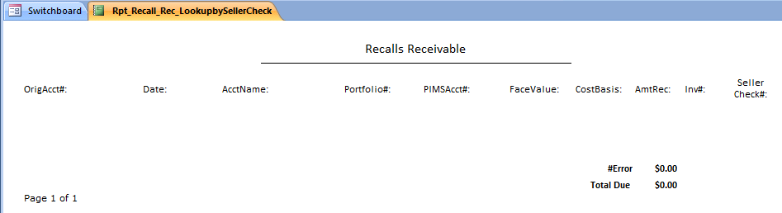
Section: Recalls and Putbacks – Receivable
Report: Recall Inv Lookup
Report: Recall Seller Check Lookup

Slide 8
Section: Recalls and Putbacks – Receivable
“Add Seller Check” data fields include:
AcctName
NewResp
Date
SellerCheck#
FaceValueofAcct
CostBasis
AmtRec
“Recall Receivables Open” data fields include:
ID
Data
OrigAcct#
AcctName
Portfolio#
CurrentResp
RecallReason
DateNoteSent
DateAcctClosed
PIMSAcct#
NewStatus
NewResp
Uploaded (y/n)
Check#
Inv#
Explanation
FaceValueofAcct
CostBasis
SalesBasis
RequestedBy
SellerCheck#
Putback
AmtRec
Seller
Company

Slide 9
Section: Recalls and Putbacks – Payable

Slide 10
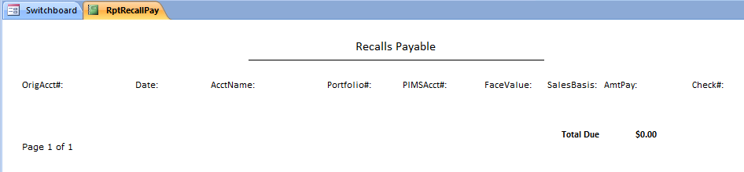
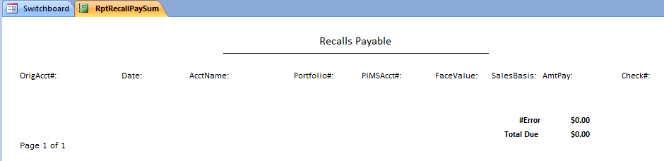
Section: Recalls and Putbacks – Payable
Report: Recalls Payable
Report: Recalls Payable Summary

Slide 11
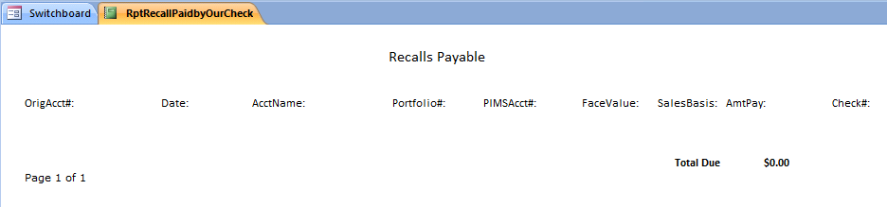
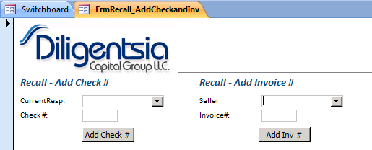
Section: Recalls and Putbacks – Payable
Report: Recall Paid by Our Check
FORM: Add Check/Inv

Slide 12
Section: DPS and Collections

Slide 13
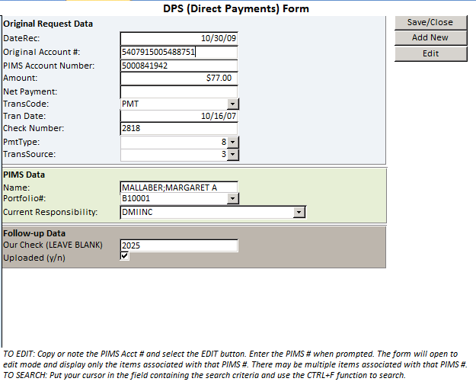
Section: DPS and Collections

Slide 14
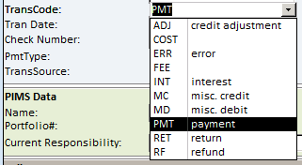
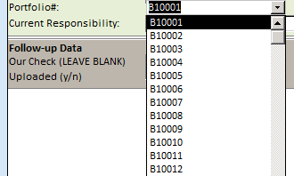
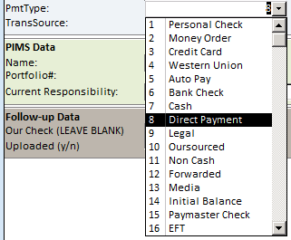
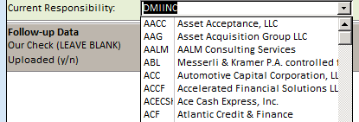

Section: DPS and Collections

Slide 15
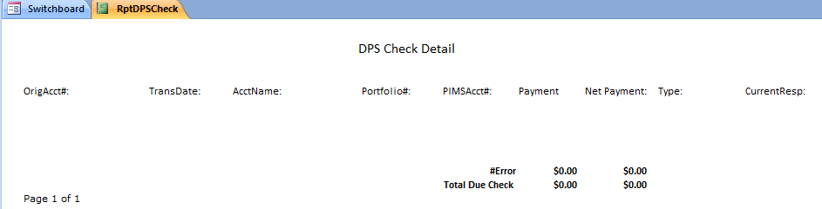
Section: DPS and Collections
Report: Find DPS Check

Slide 16
Section: DPS and Collections – Payable
The following retrieve the actual data:
Add In-House Check (error – does not retrieve data)

Slide 17
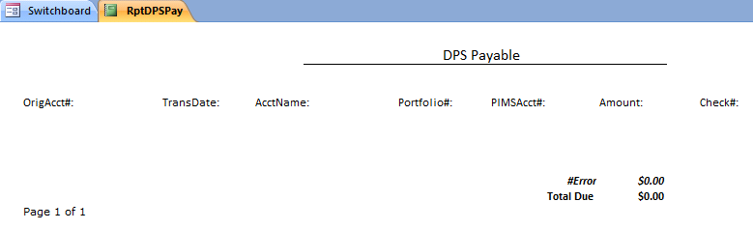
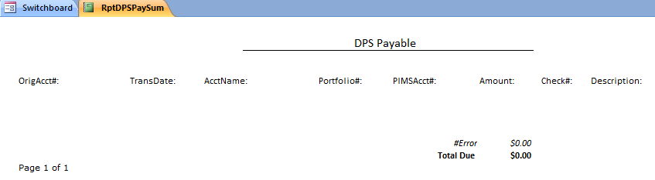
Section: DPS and Collections – Payable
Report: DPS Payable
Report: DPS Payable Summary

Slide 18
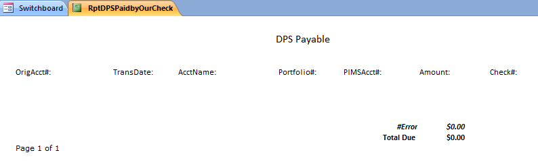
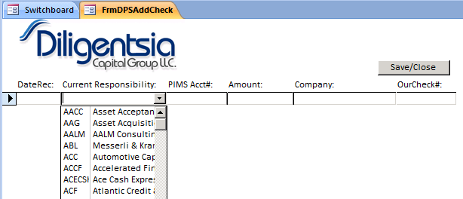
Section: DPS and Collections – Payable
Report: DPS Paid by Our Check
FORM: Add Check

Slide 19
Section: Other Items

Slide 20
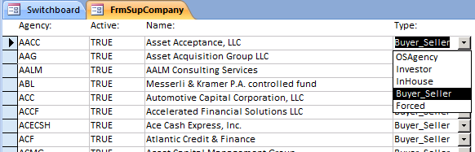
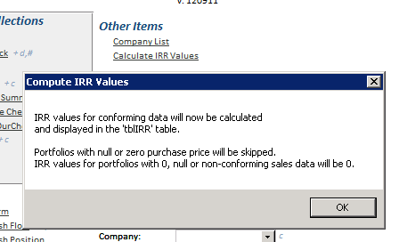
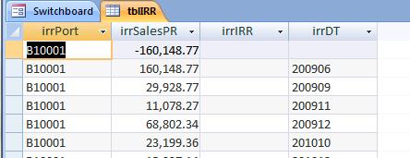
Section: Other Items
Clicking this
Brings up this popup
And when clicking this
You get this

Slide 21
Section: Media

Slide 22
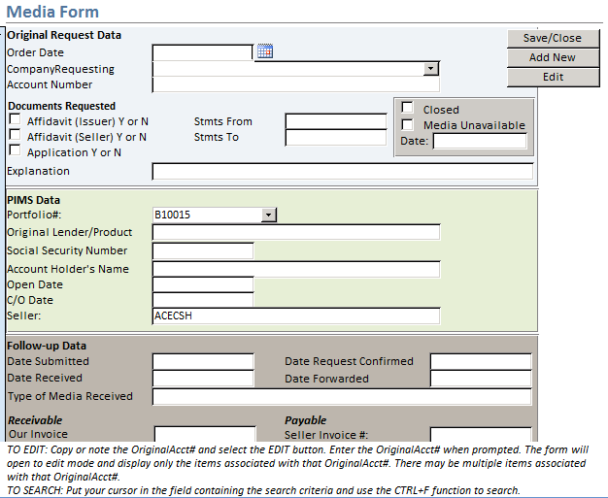
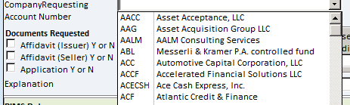
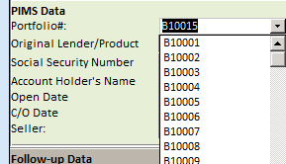
Section: Media

Slide 23
Section: Media
“Media Not Submitted”, “Media Not Confirmed”, “Media Not Received”, and
“Media Not Forwarded” data fields include:
OrderDate
CompanyRequesting
Portfolio#
OriginalLender/Product
OrigAcct#
SSN
AcctName
Application
Affidavit(Issuer)
Affidavit(Seller)
StmtsFrom
StmtsTo
OpenDate
C/Odate
Explanation
GMC Manager Approval Y or N
CompanySubmittedTo
DateSubmitted
DateConfirmed
SellerFee
DateSellerPaid
OurFee
DateReceived
DateForwarded
TypeReceived
OurInvtoBuyer
OtherNotes:
Unavailable
Closed
UnavailableDate
SellerInv#
DatePayRec
BuyerCheck#
OurCheck#

Slide 24
Section: Media – Receivable

Slide 25
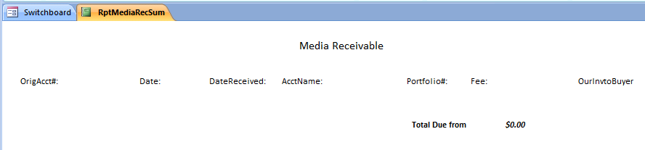

Section: Media – Receivable
Report: Media Receivable Summary
Report: Media Receivable

Slide 26
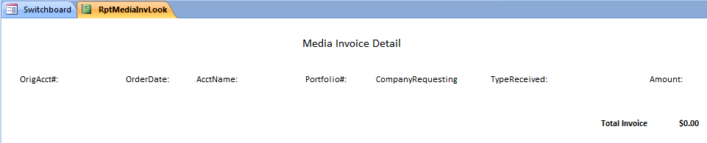
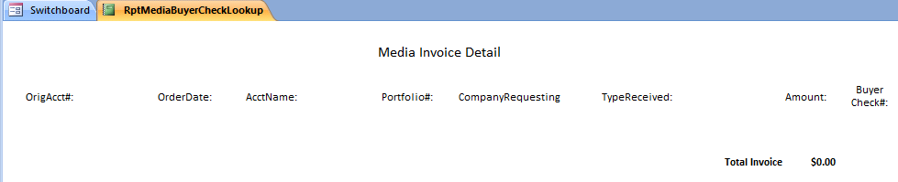
Section: Media – Receivable
Report: Media Inv Lookup
Report: Media Buyer Check Lookup

Slide 27
Section: Media – Payable

Slide 28
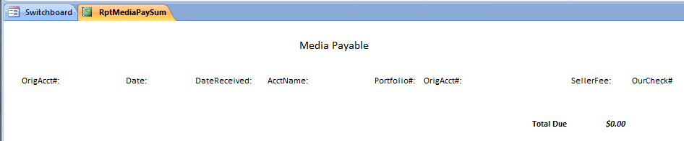
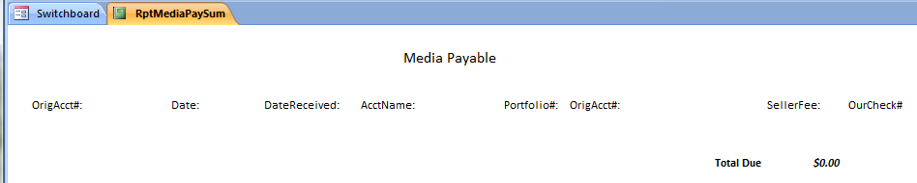
Section: Media – Payable
Report: Media Payable Summary
Report: Media Payable

Slide 29
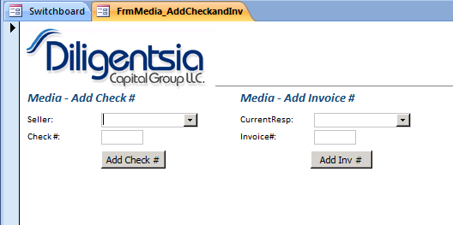
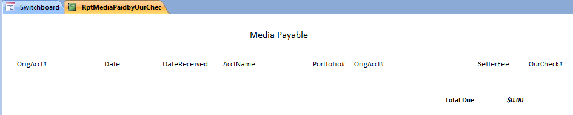
Section: Media – Payable
Report: Add Check/Inv
Report: Media Paid by Our Check

Slide 30
Section: Portfolio

Slide 31
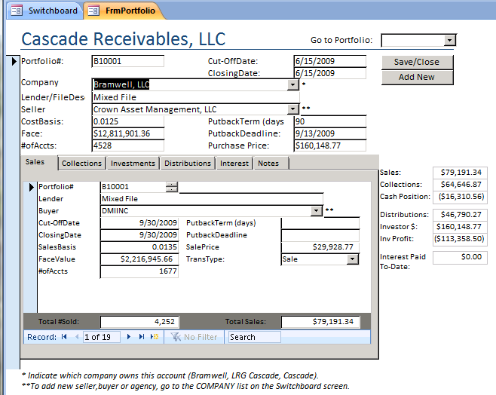
Section: Portfolio

Slide 32
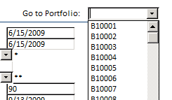
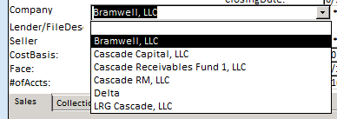

Section: Portfolio

Slide 33
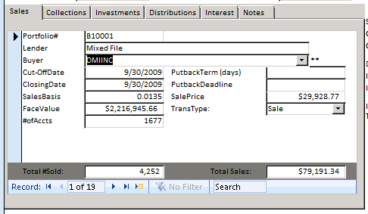
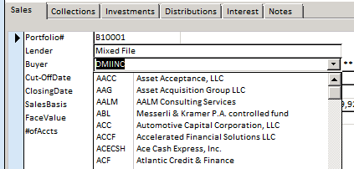
Section: Portfolio

Slide 34
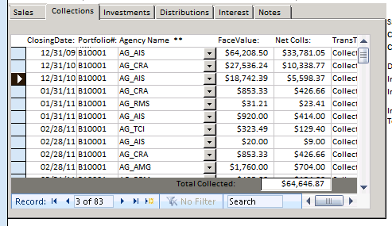
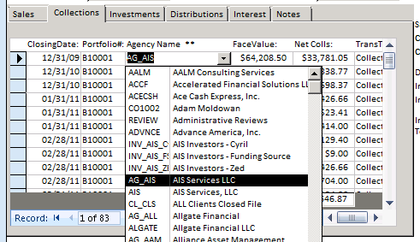
Section: Portfolio

Slide 35
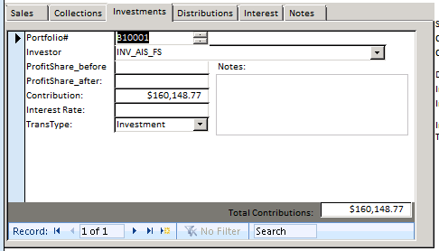
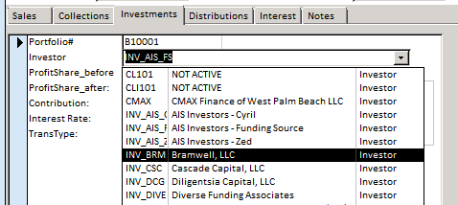
Section: Portfolio

Slide 36
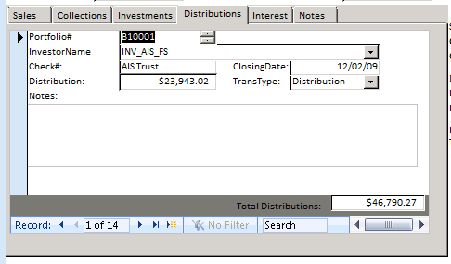
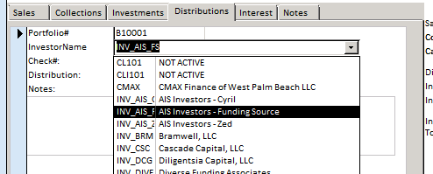
Section: Portfolio

Slide 37
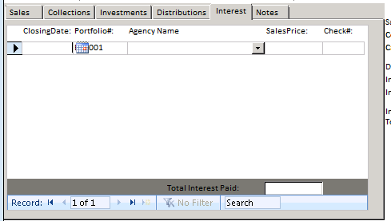

Section: Portfolio

Slide 38

Section: Portfolio

Slide 39
Section: Portfolio
“Portfolio Cash Flow” data fields include:
Portfolio#
ClosingDate
TransType
SalesPrice
Company
“Portfolio Cash Position” data fields include:
Portfolio#
ClosingDate
PurchasePrice
SumOfSales
CashPos
Company
Return on Capital

Slide 40


Section: Portfolio
Report: Portfolio Summary
Report: Collections Reconciliation

Slide 41

Section: Portfolio
Report: Portfolio Transactions

Slide 42
Section: Portfolio
“Purchases” data fields include:
Portfolio#
ClosingDate
Seller
PurchasePrice
“Sales” data fields include:
Portfolio#
ClosingDate
Buyer
FaceValue
SalesBasis
SalesPrice
TransType

Slide 43

Section: Report Criteria

